Slide 1



Telco Churn
Our mean objective is to understand what are the biggest factors that leads to churn and prevent that

Slide 2

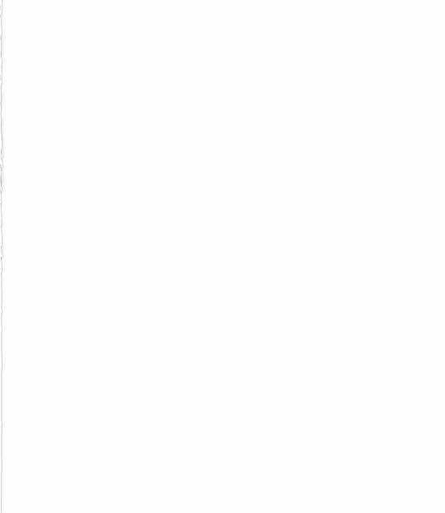
Purpose
Create an application to predict if a customer will indeed churn
Develop focused customer retention programs

Slide 3
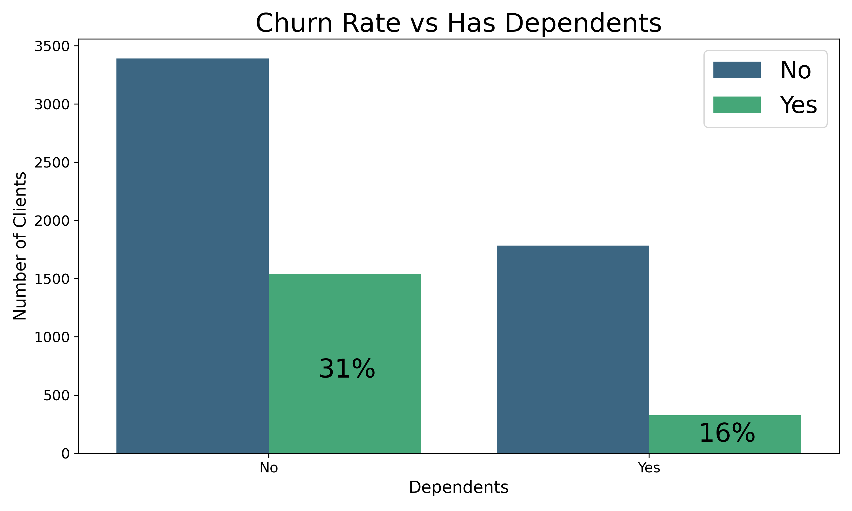
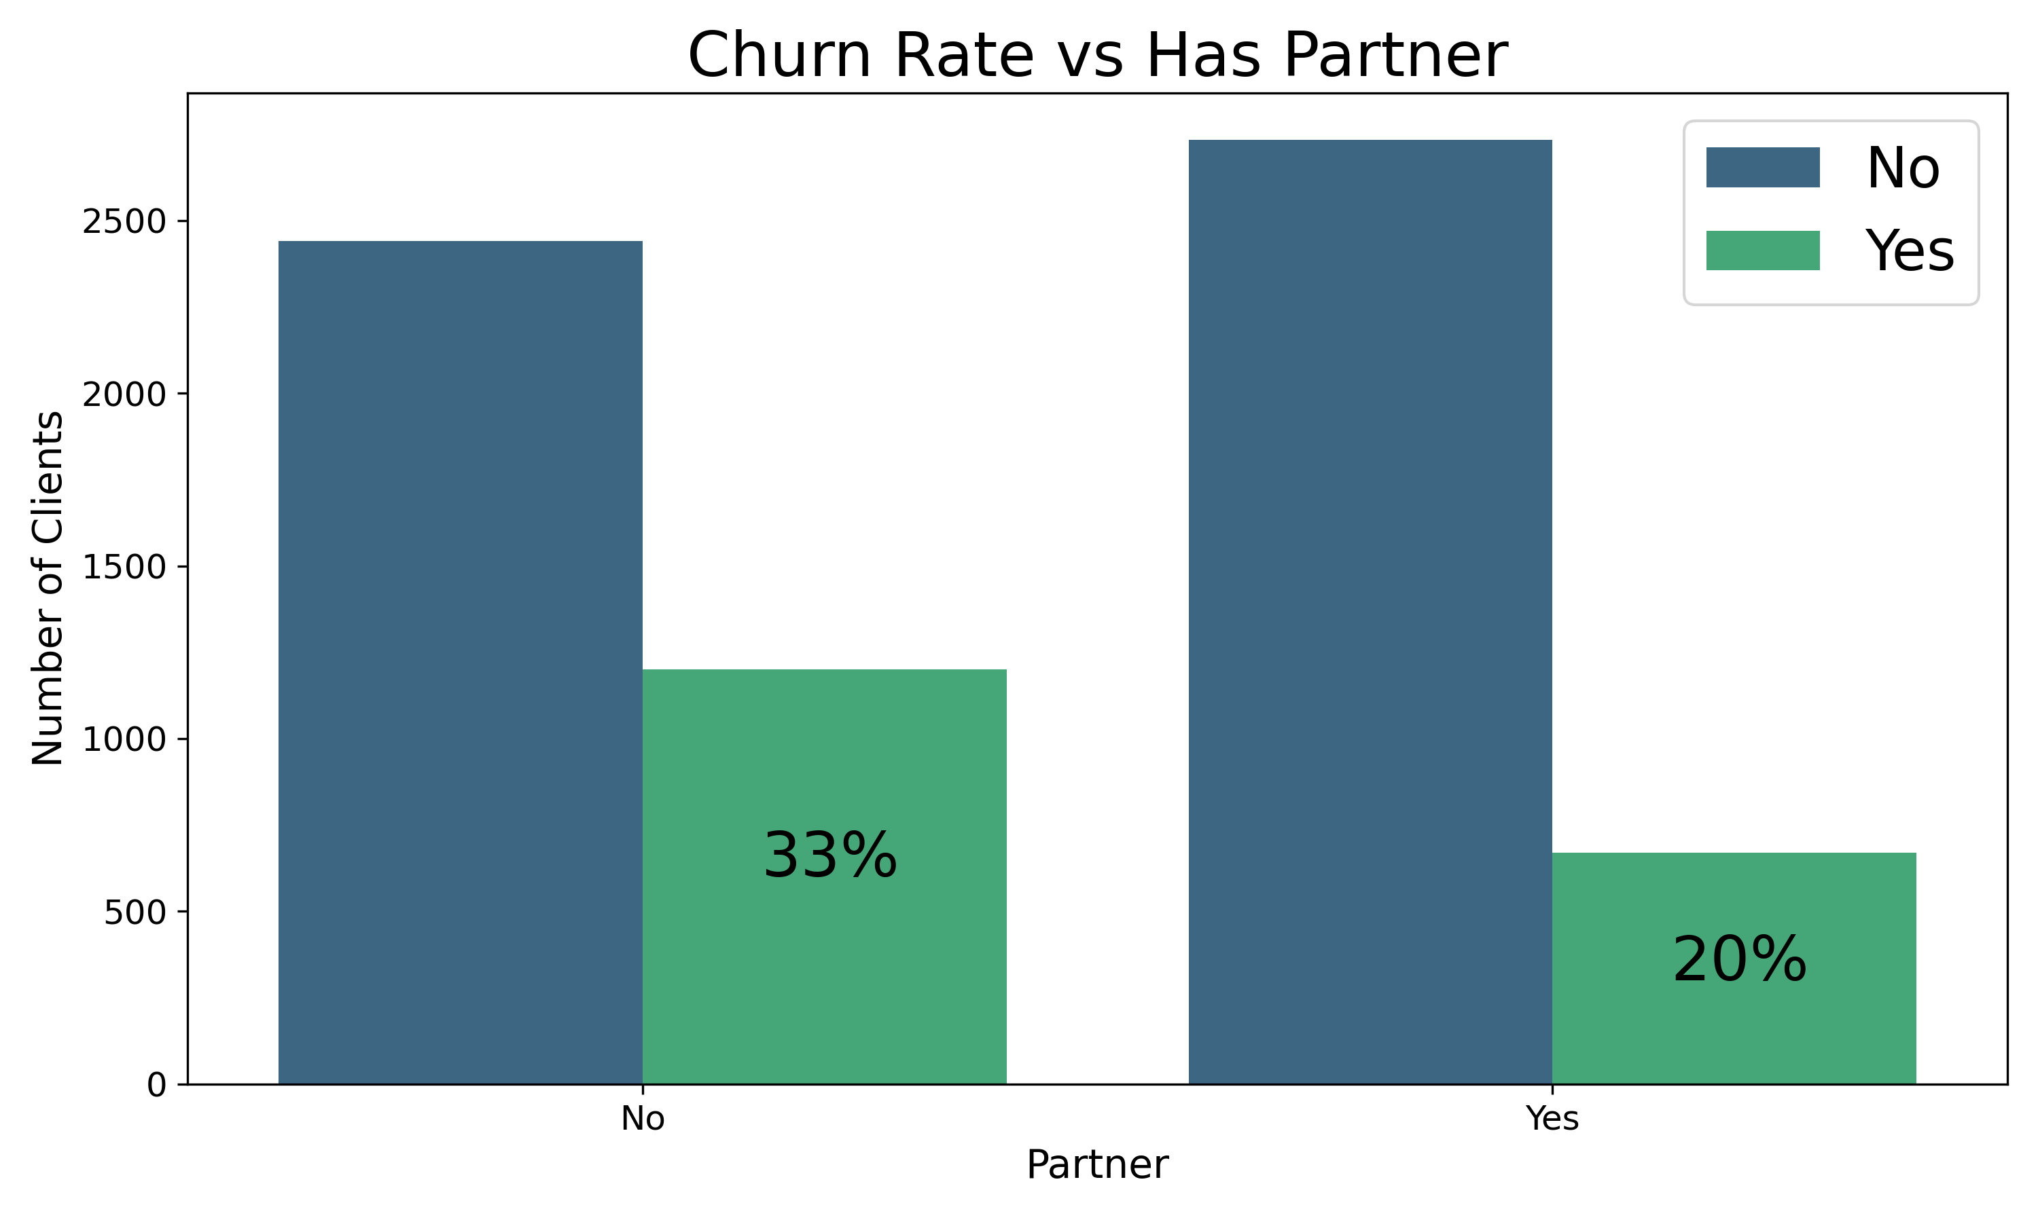
Exploratory Data Analysis
Customer Profile
Clients who has no dependents tend to churn almost the double comparing to the clients that has dependents
Also, the clients that has no partner tends to churn more as well

Slide 4
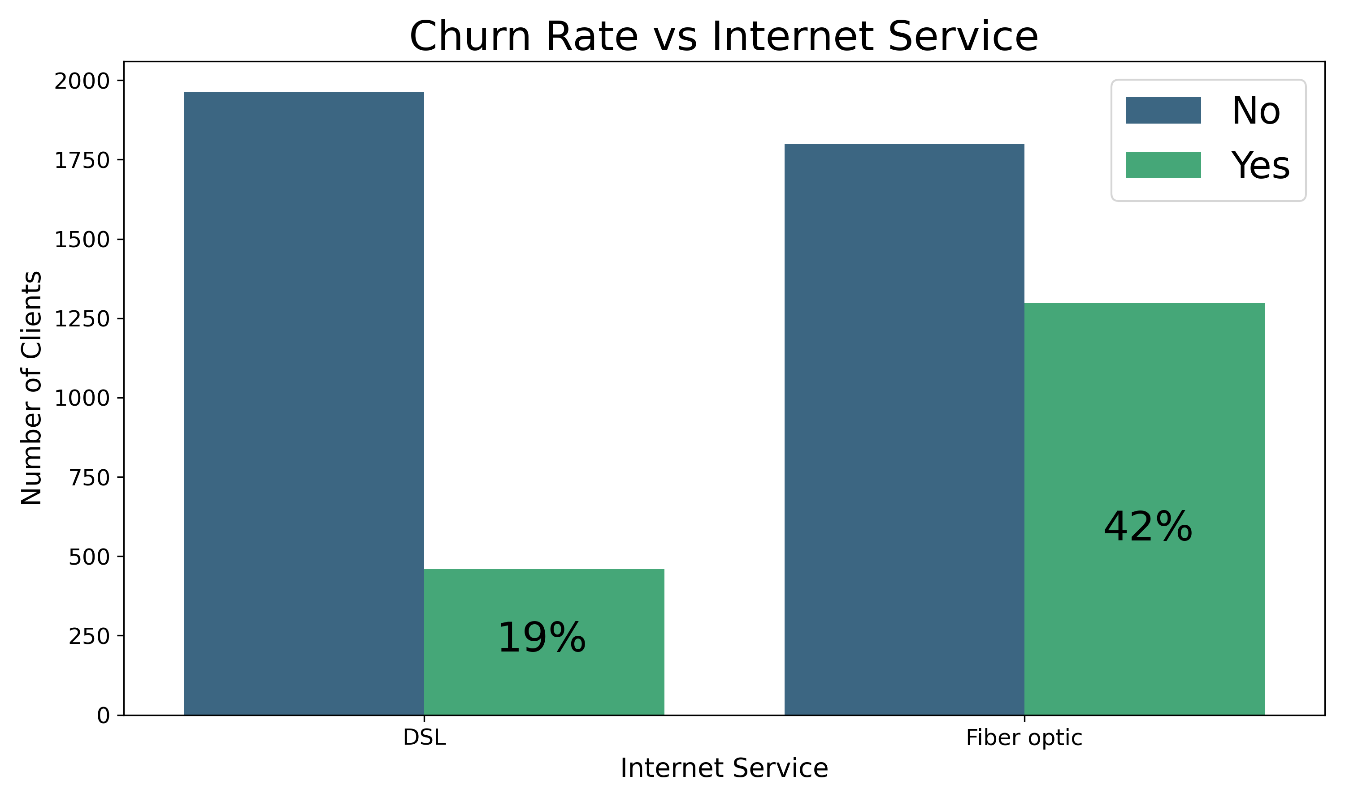
Exploratory Data Analysis
Services
Clients with Fiber Optic Churn dramatically more than DSL
WHY ?
There’s any problem with the Fiber Optic?

Slide 5
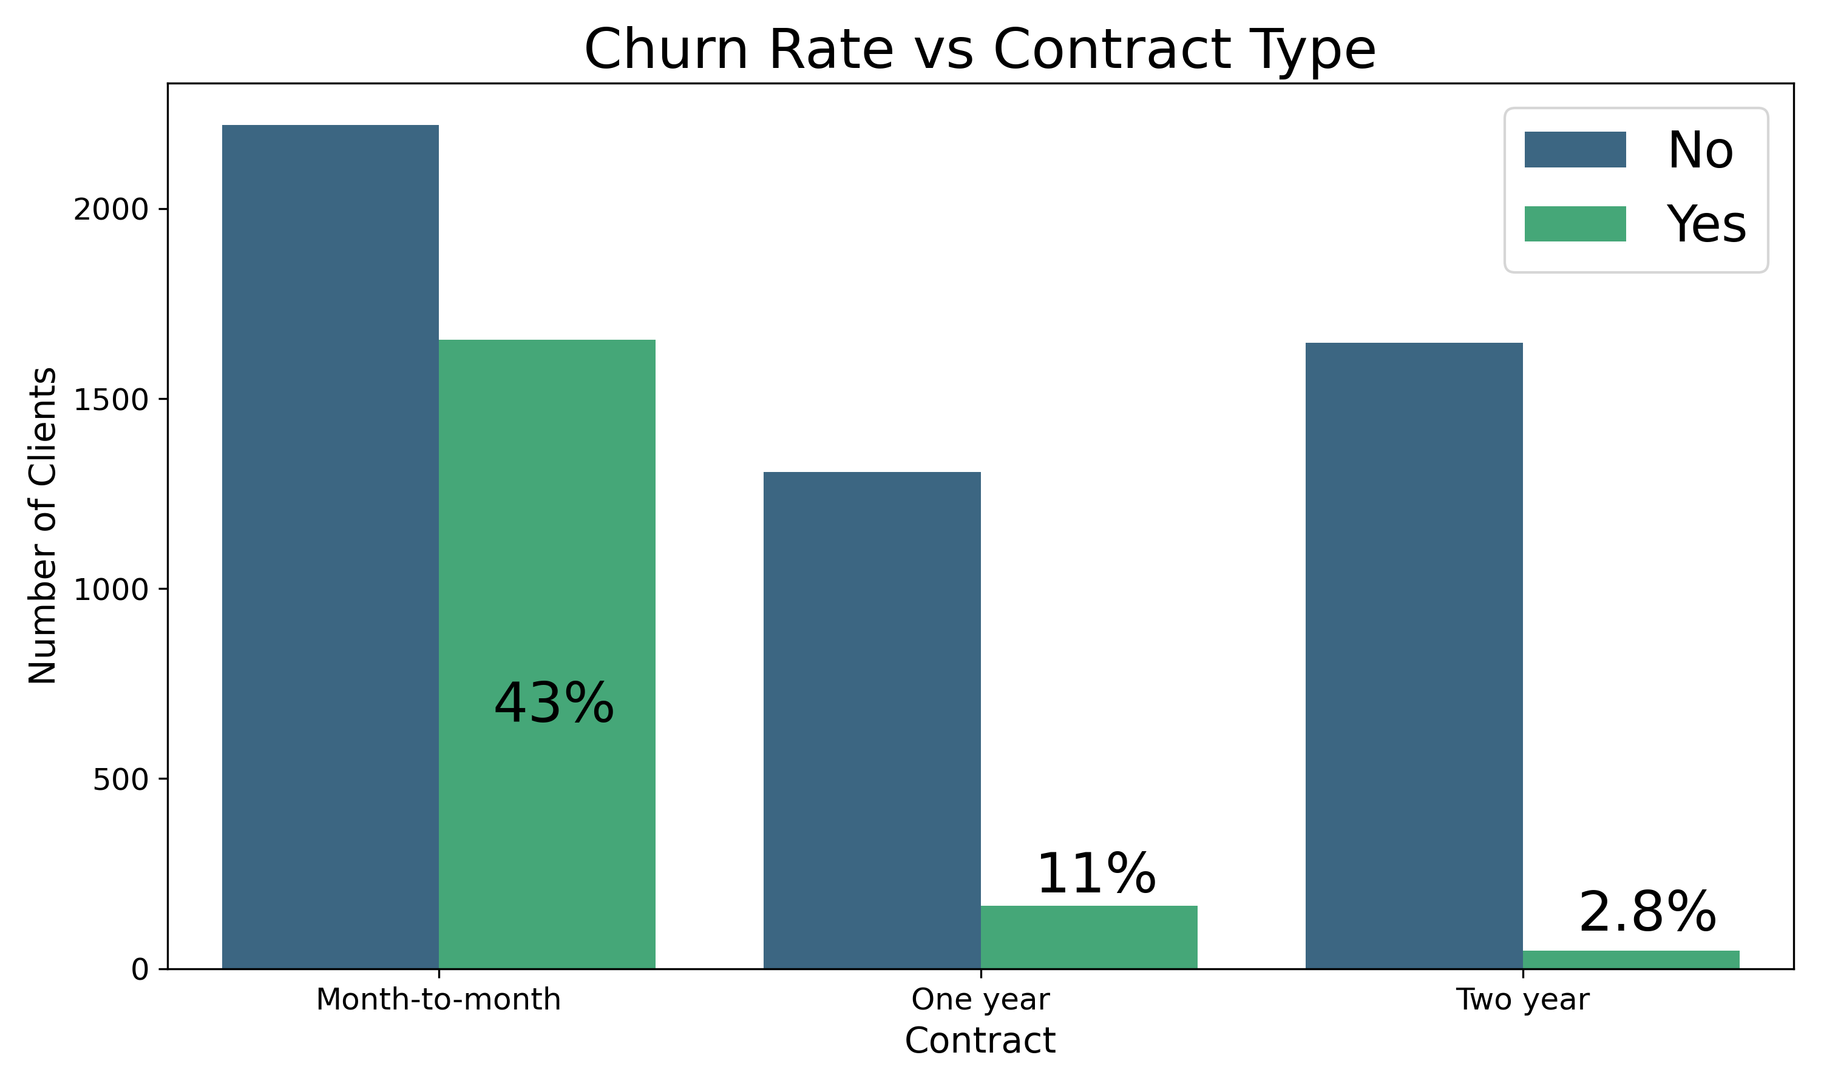
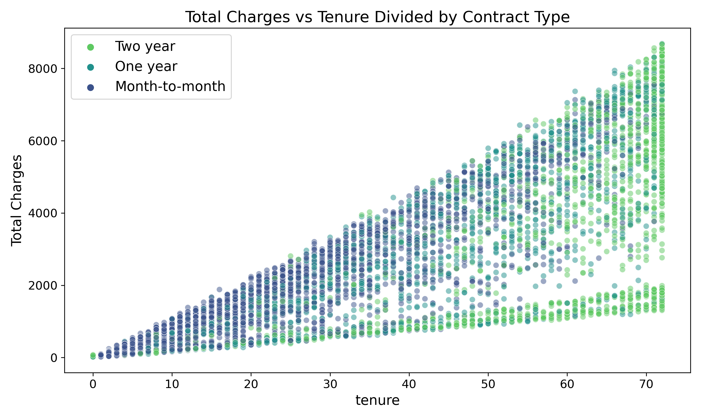
Exploratory Data Analysis
Contract Nuances
The Clients that stay the longgest are those who has longggest contracts
The same way the clientes that has a low tenure rate usually has month-to-month contract and the churn hate is more than 10 times bigger comparing to 2 years contract

Slide 6
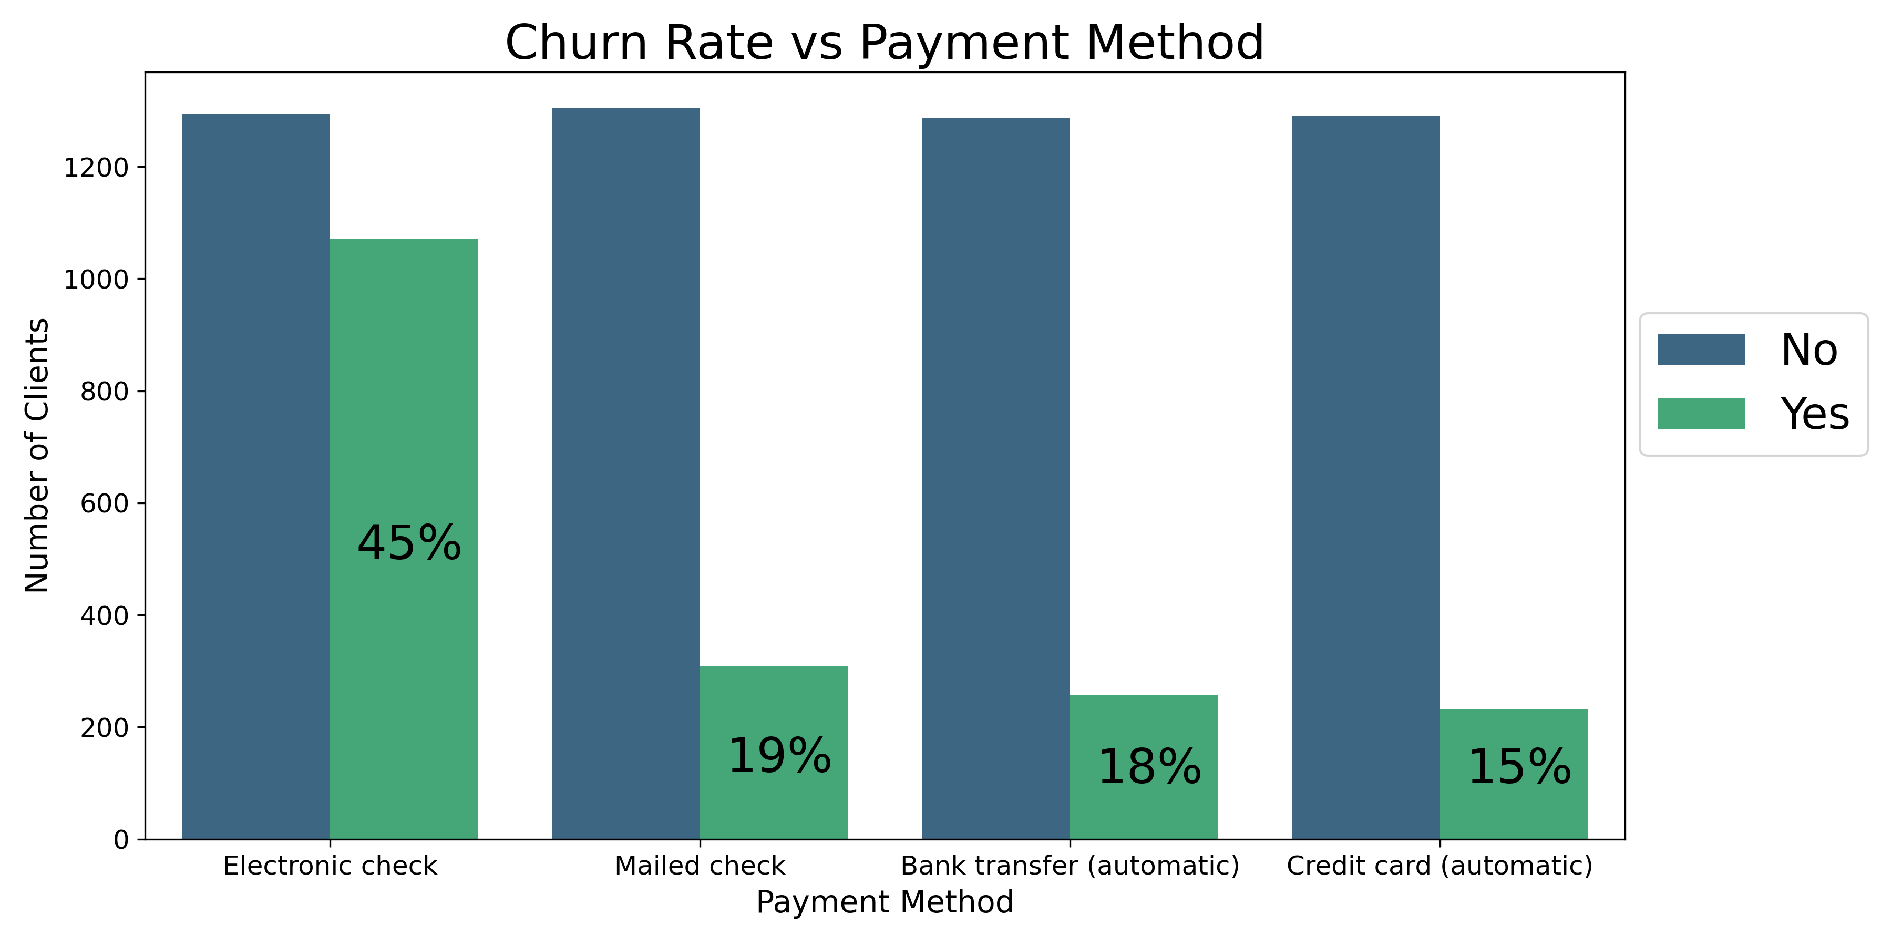
Exploratory Data Analysis
Contract Nuances
45% of the customer who has eletronic check as a payment method churn
The customer with automatic ways of payment tends to churn way less

Slide 7
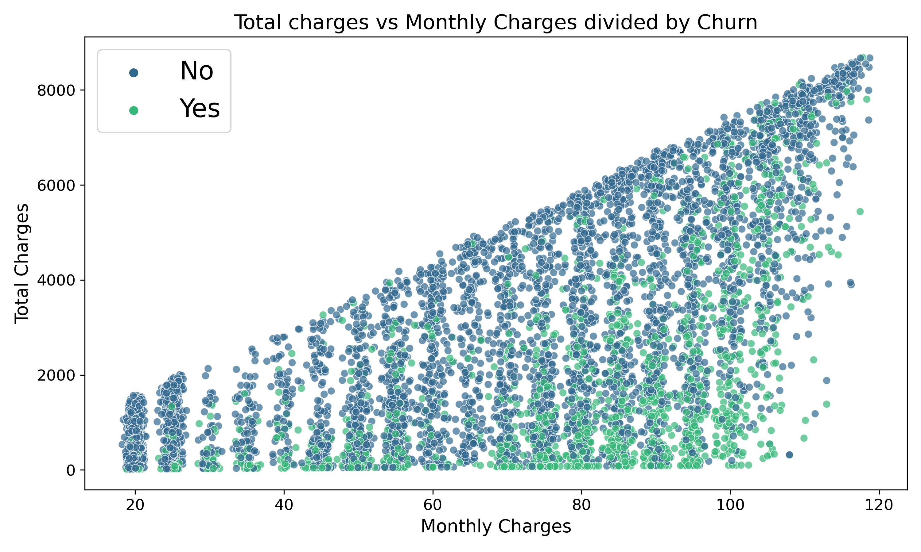
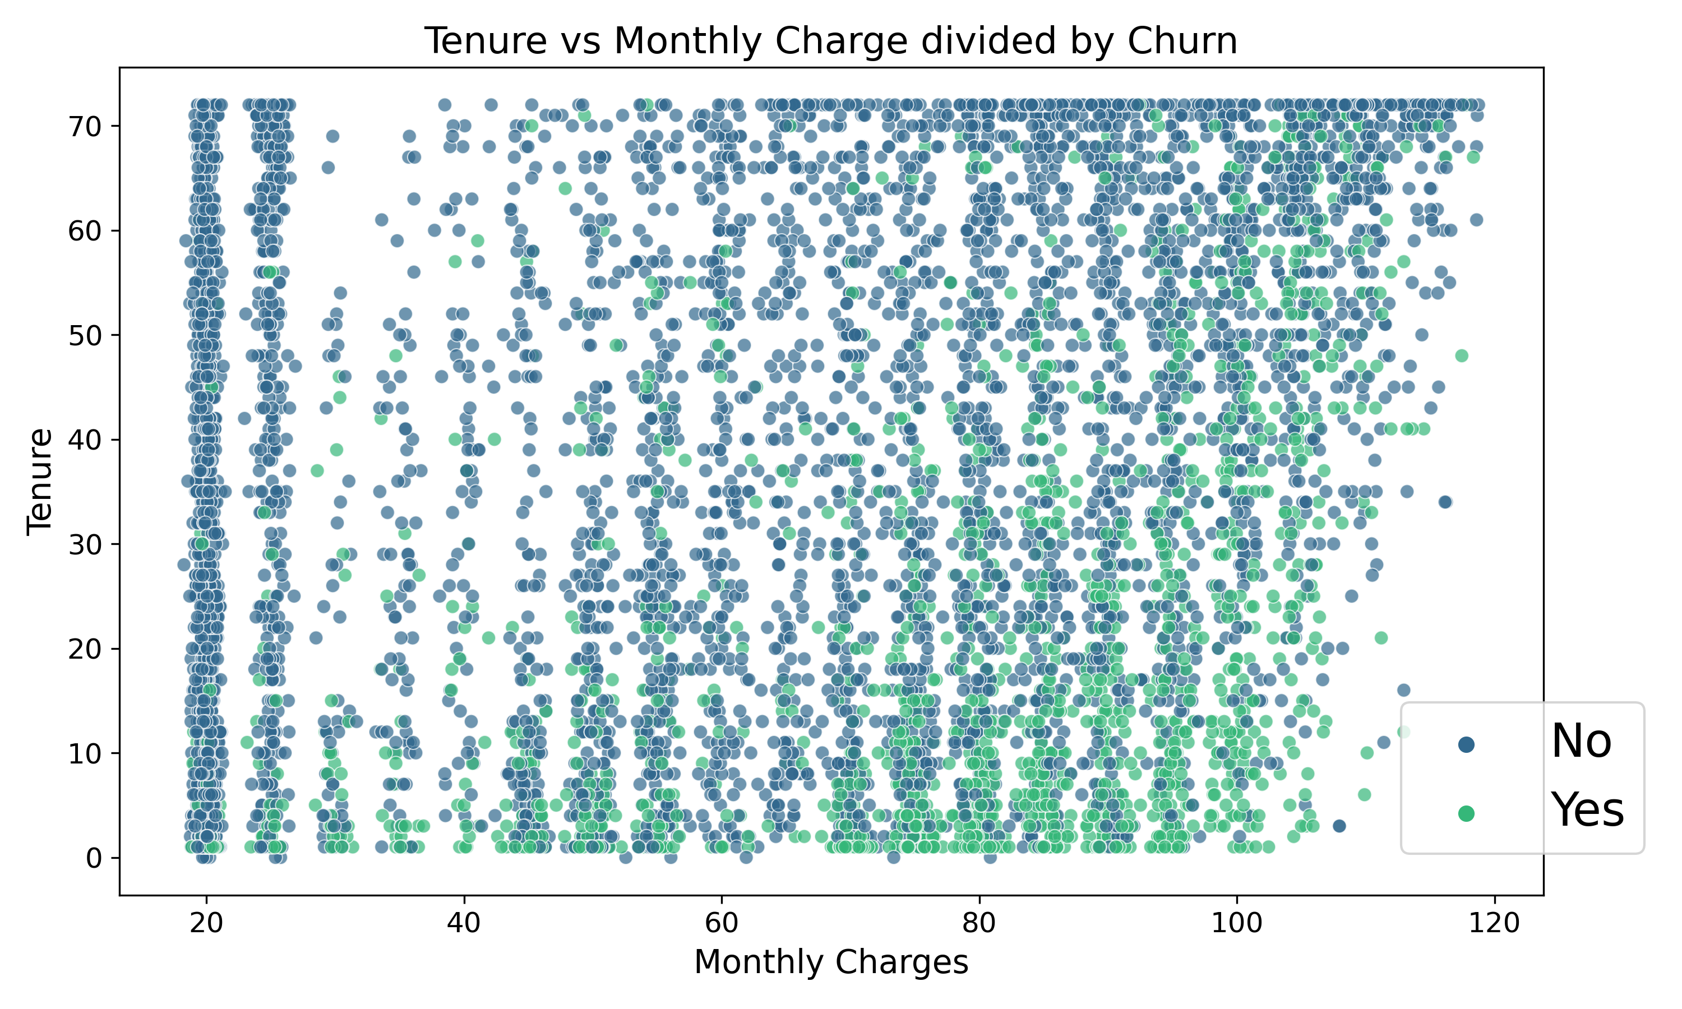
Exploratory Data Analysis
Charges
Customers with high charges tend to churn more specially if they have highly charges since the beggining

Slide 8
Machine Learning
Problem Definition:
We want to predictic if cliente will churn or not so we have a Classification Problem
Metrics
Precision: We want to predict with high precision the customers that will churn in order to create retention program and incentives for the customer to stay with the company

Slide 9
Model Building
Support Vector Machines
The Support Vector Machine was the model who performs best with:
70% of Precision
Random Forest
Logistic Regression

Slide 10
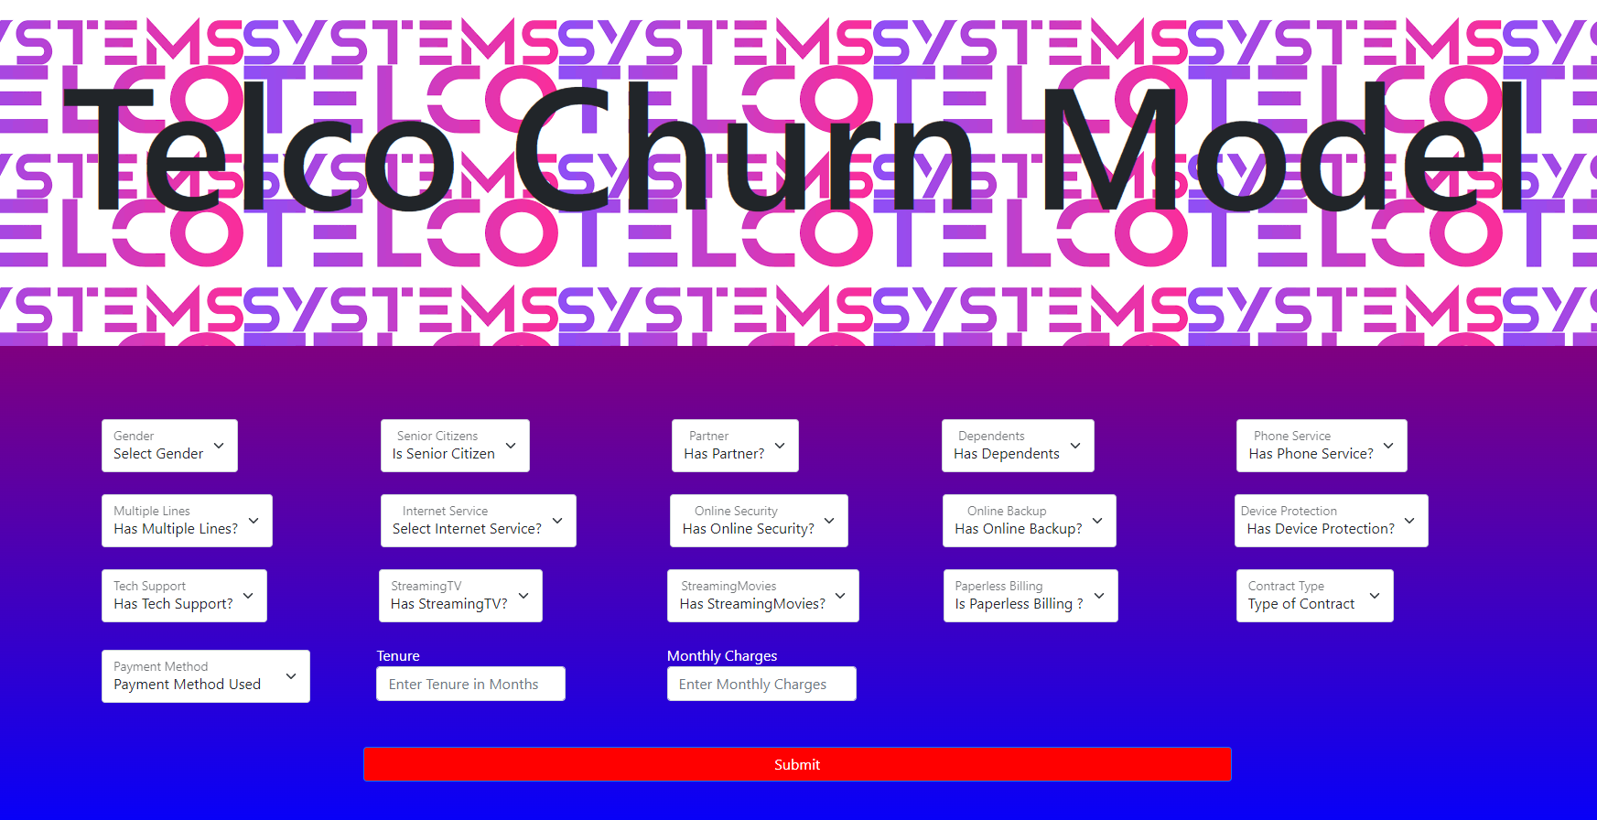
Flask App
We create a flask app where we can insert the information about the customer and the model will predict if the customer will churn or not

Slide 11
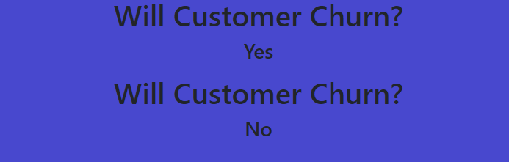
Prediction
A prediction for two diferent clients given their information

